Slide 1
Summary Dashboard
Summary Dashboard
HR Analytics
DANG DAI DUONG
MENTORSHIP PROGRAM 2024

Slide 2
Agenda
Top-down Approach
Brain-storm on Image
Table relationship (Subset – bus matrix)
Database

Slide 3
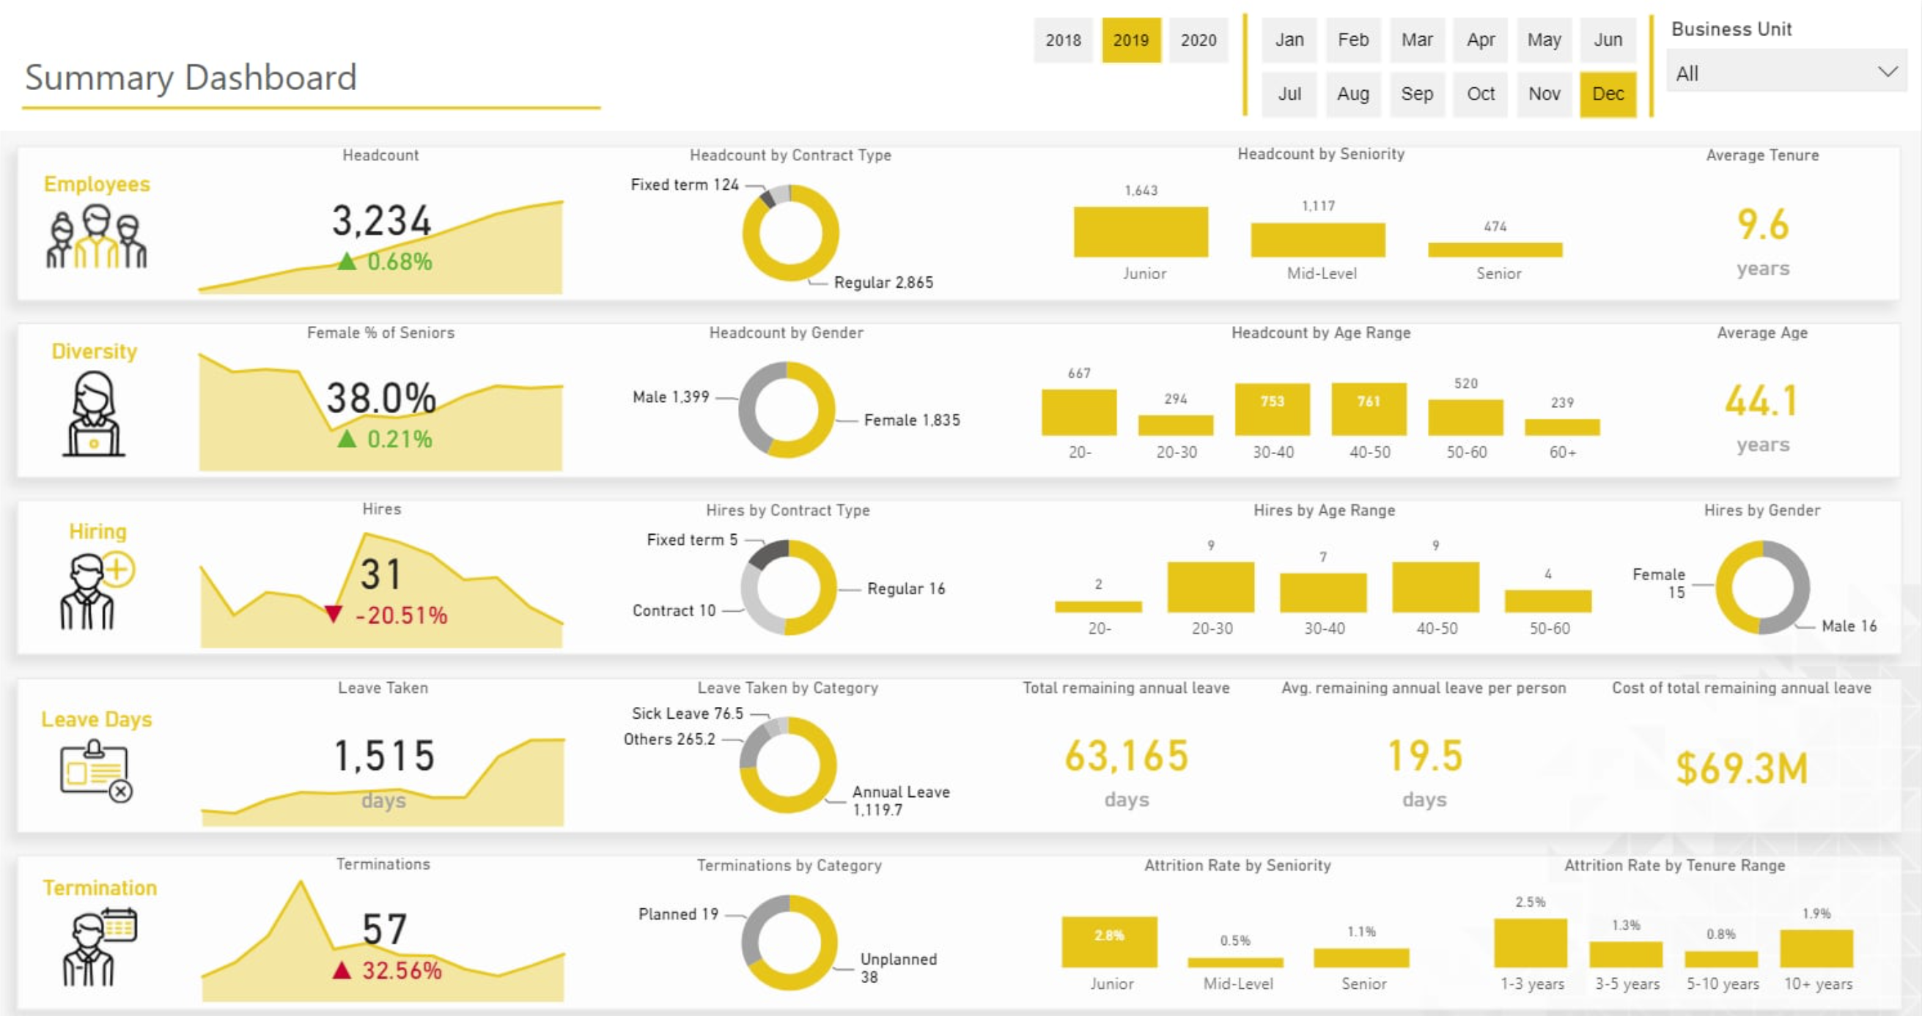
Summary Dashboard

Slide 4
Top-Down Approach

Slide 5
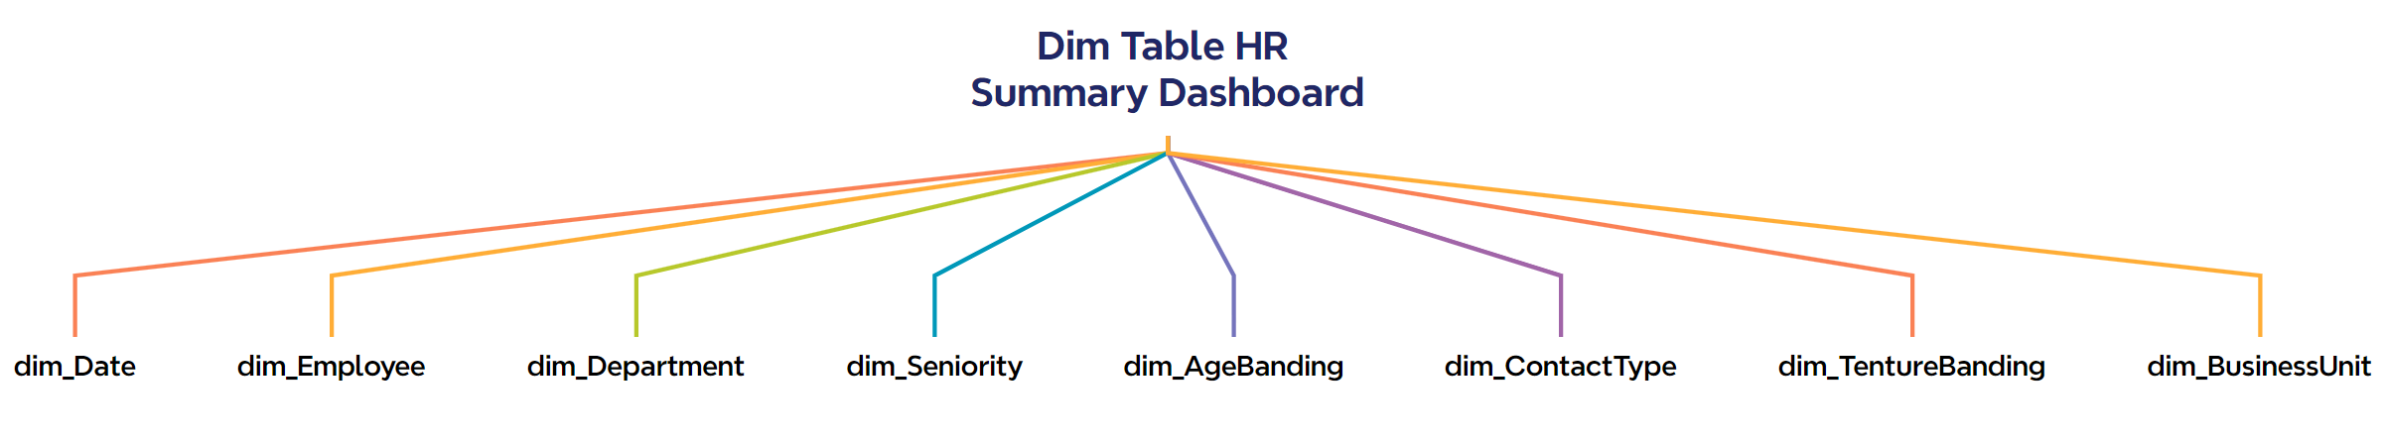
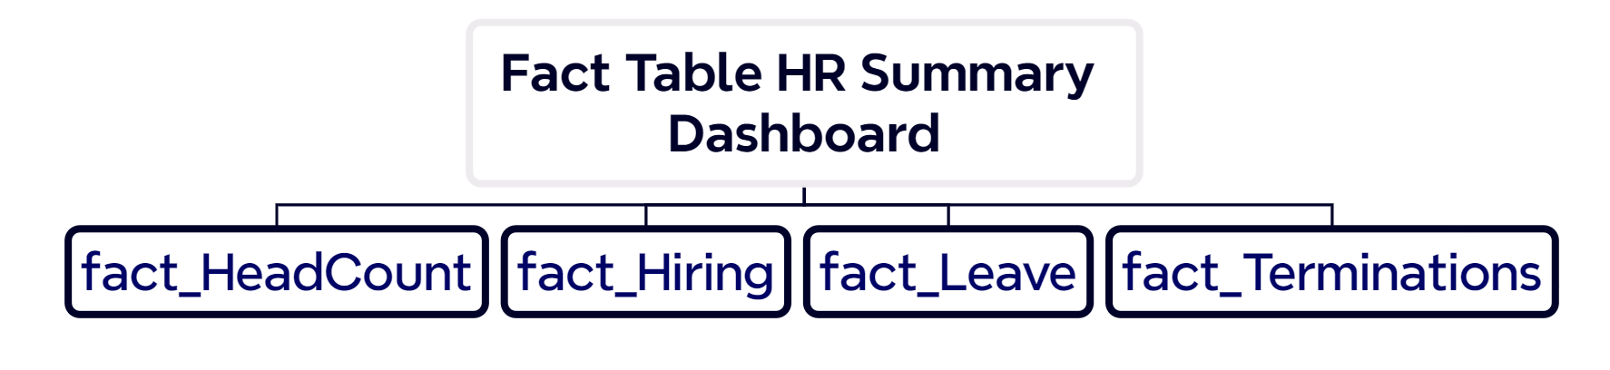
—Someone Famous

Slide 6
01
Brain-storm by Image

Slide 7
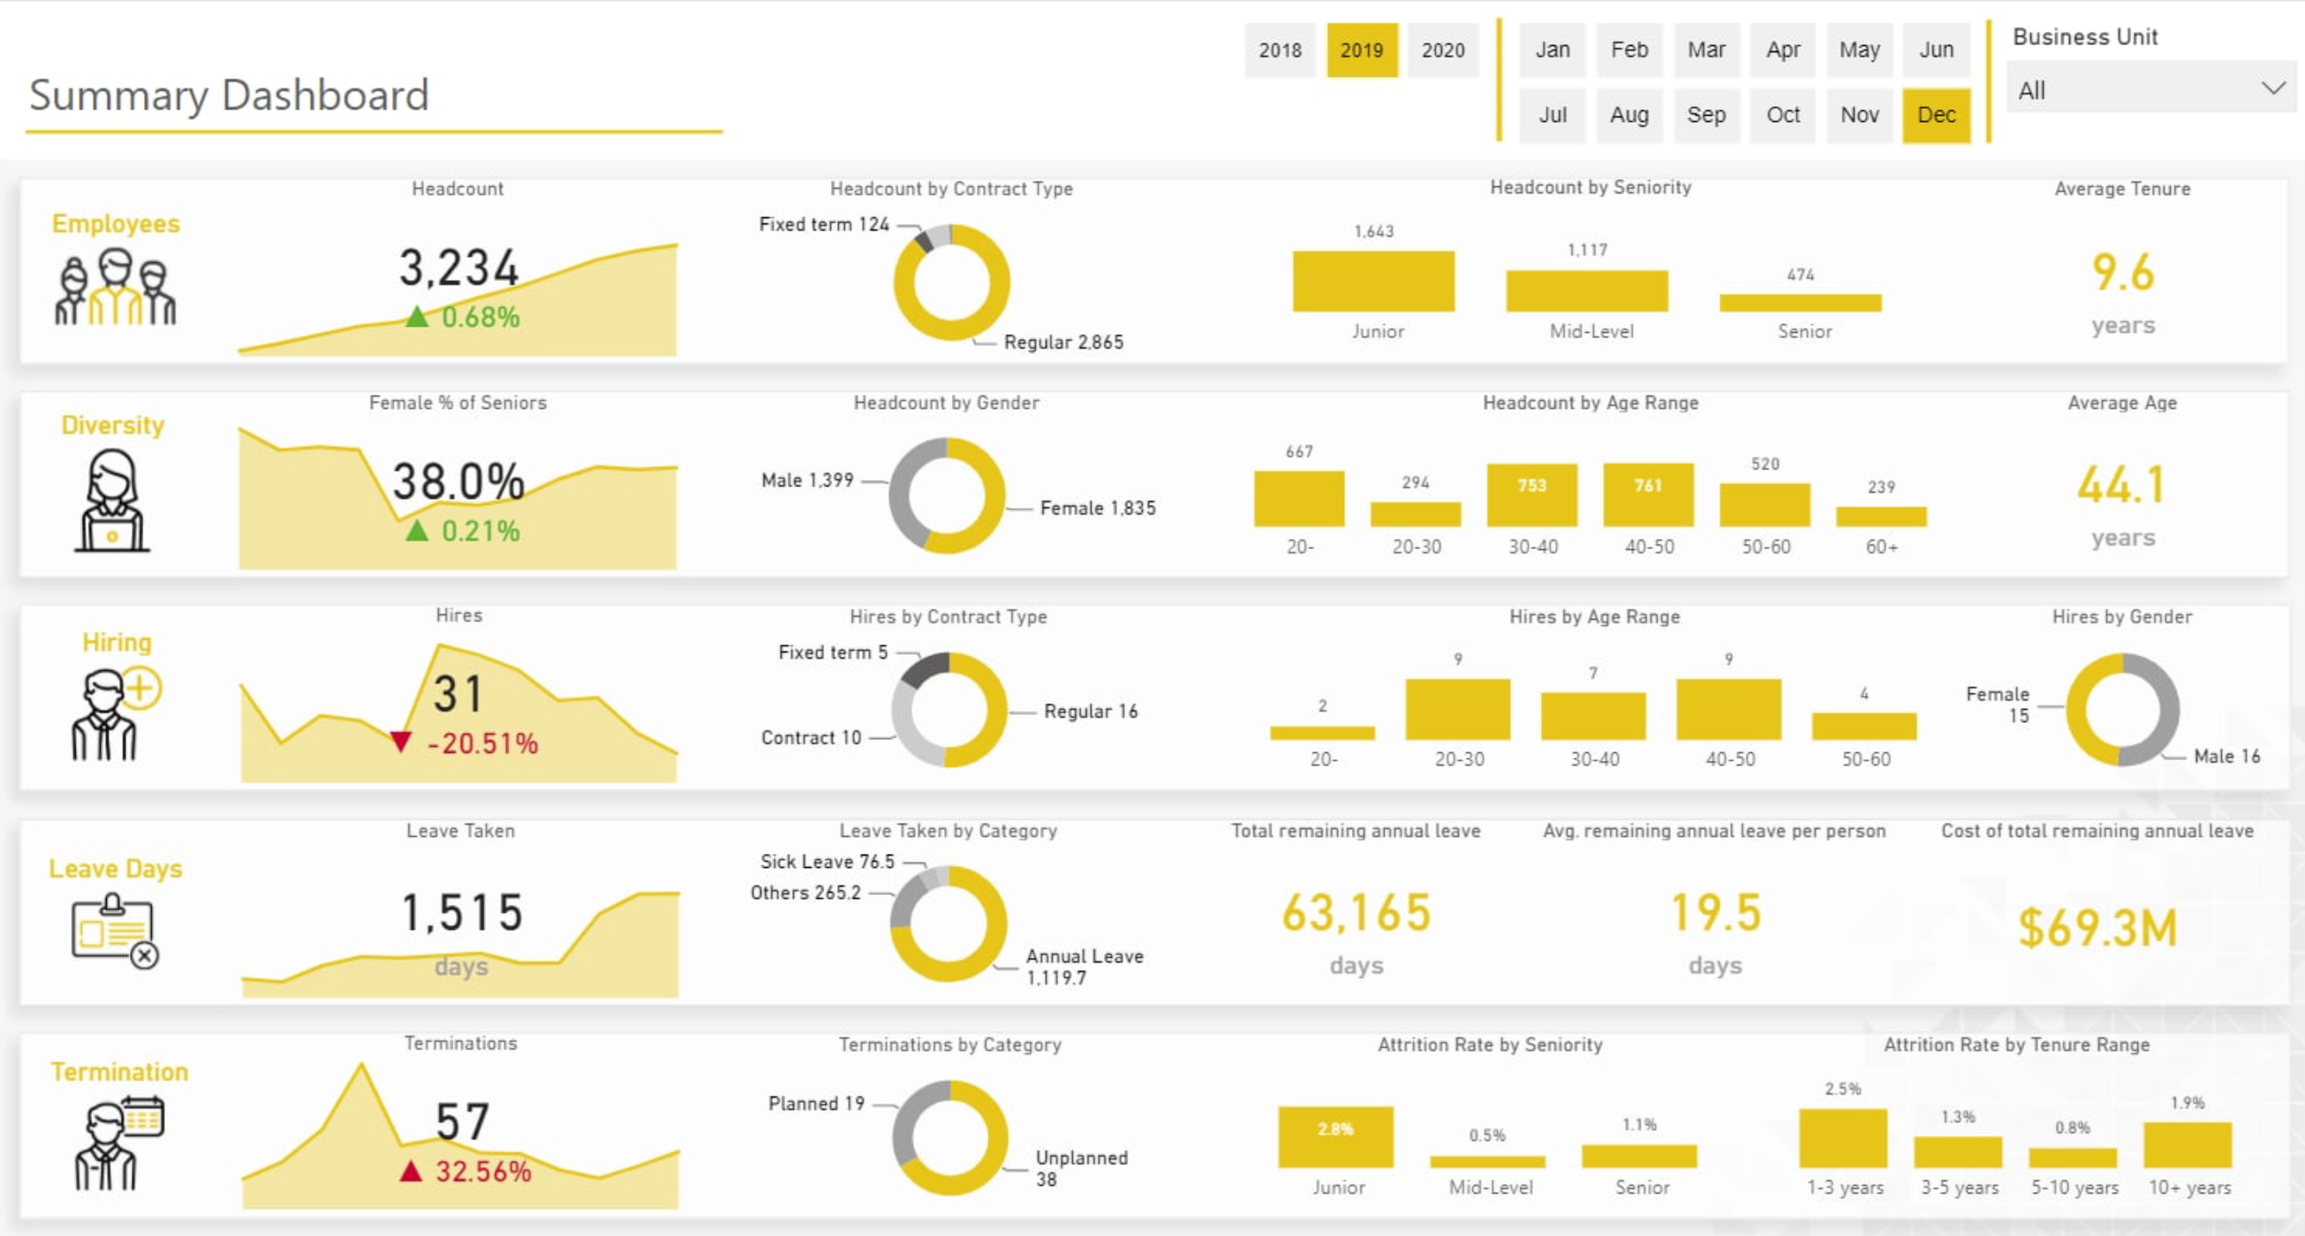
Year – dim_Date
Month – dim_Date
Dim_BusinessUnit
How many Employee in Company on MM in YYYY
What TYPE CONTRACT of this EMPLOYEE
How many “Junior” | “Mid-Level” | “Senior” in company at MM/yyyy
AVG(
dim_Tenure)
How many Emp , have Gender is “F”, and SeniorityLevel is “Senior”
at MM/yyyy
Group by Gender, with all Emp at MM/yyyy
AgeBanding (From-To) have how many Emp ? at MM/yyyy
AVG(Age) of all Emp at MM/yyyy
How many Emp have been Hired at MM/yyyy – MoM / YoY
What Contract type in BusinessUnit of the Emp was Hires at MM/yyyy
AgeBanding (From-To) of Emp was hired at MM/yyyy
What GENDER of Emp was hired
How many Date that Emp have taken leave at MM/yyyy
What’s reason that Emp have taken
Total SUM() the remaining leave days after the (Emp) has taken leave at MM/yyyy
AVG() of remaining leave days / Emp
How much Cost of SUM() remaining annual leave
How much Terminations at MM/yyyy
What’s reason that Emp terminations
The % of GROUP BY (SeniorityLevel) terminations
AgeBanding(From-To) have how many % of Emp terminations

Slide 8
Subset of data warehouse bus matrix for HR Analytics processes.

Slide 9
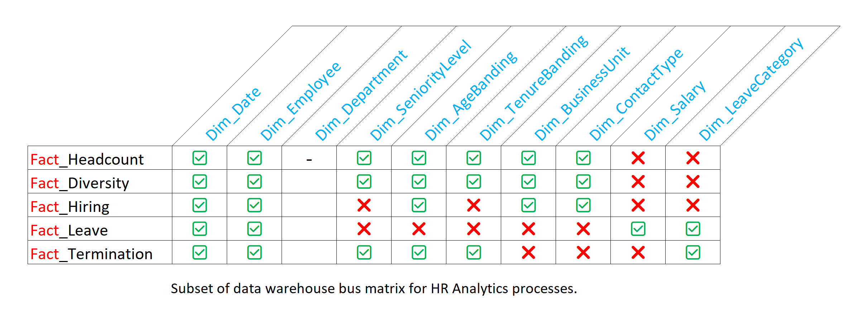

Slide 10
02
Database

Slide 11
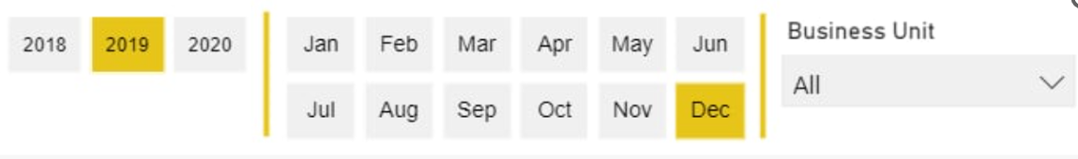
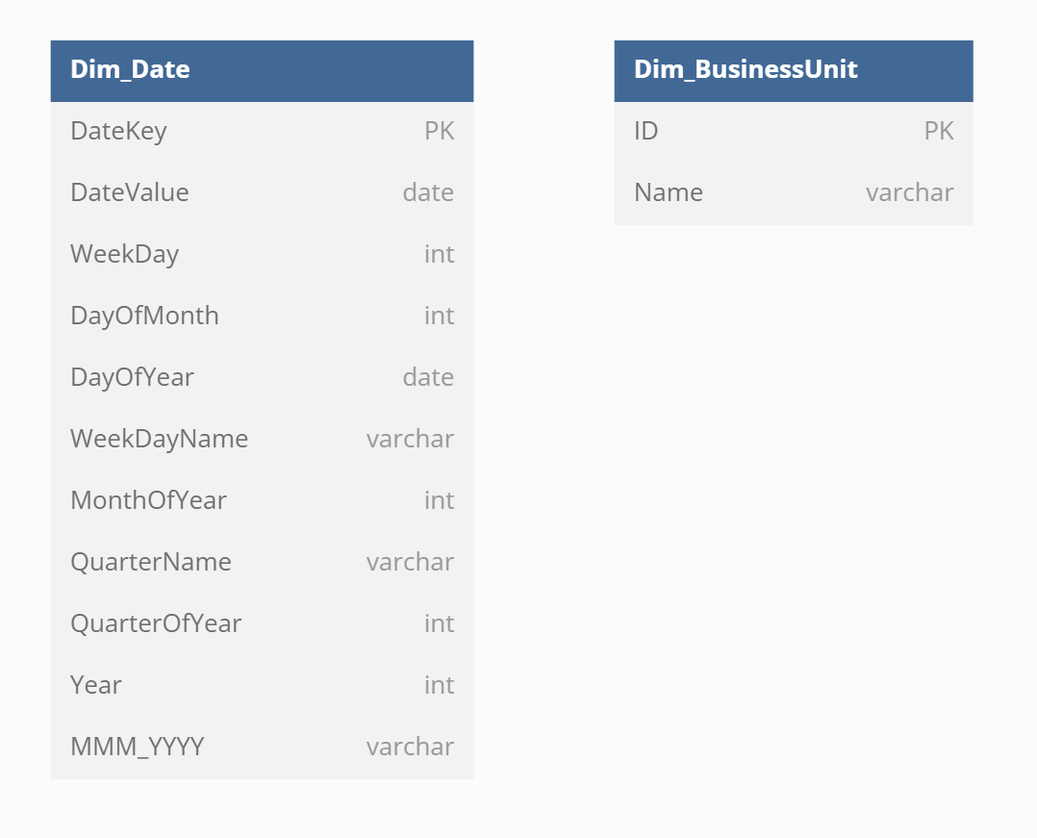

Slide 12
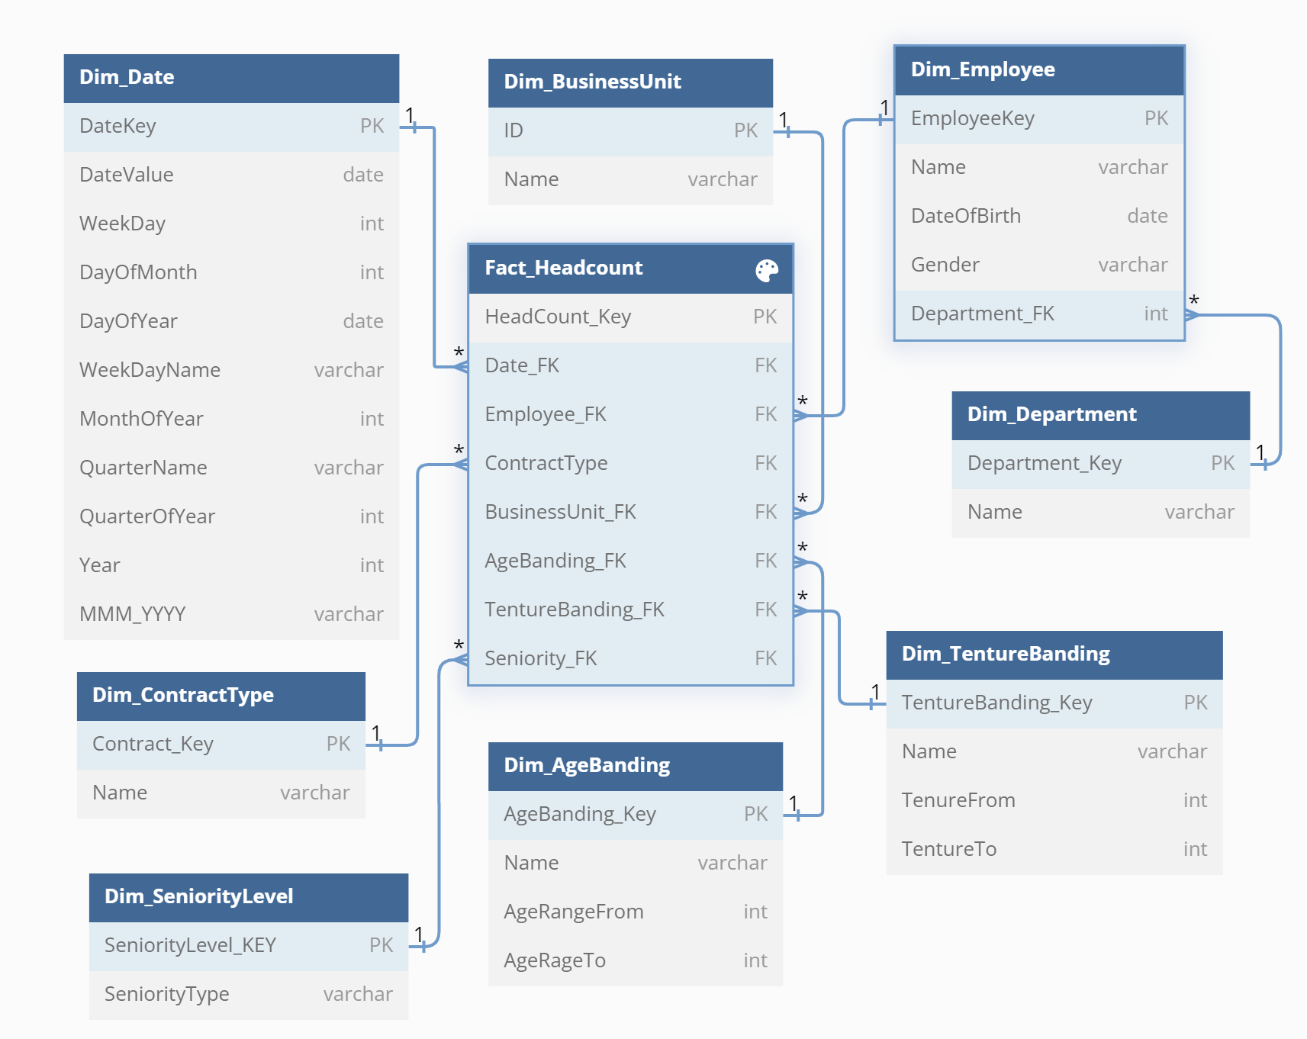

Slide 14
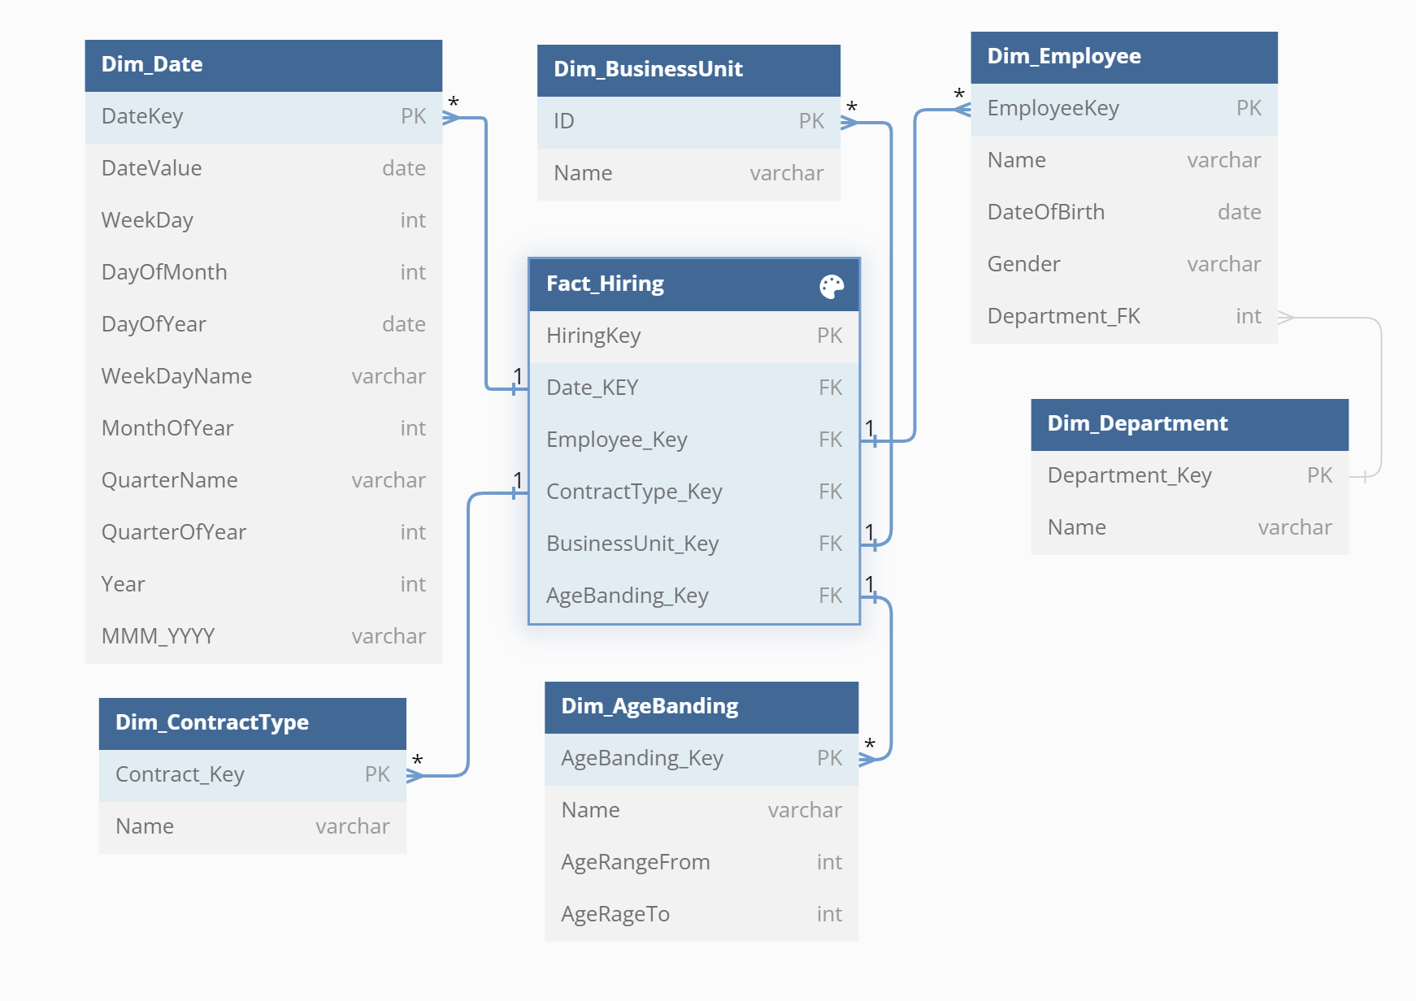

Slide 15
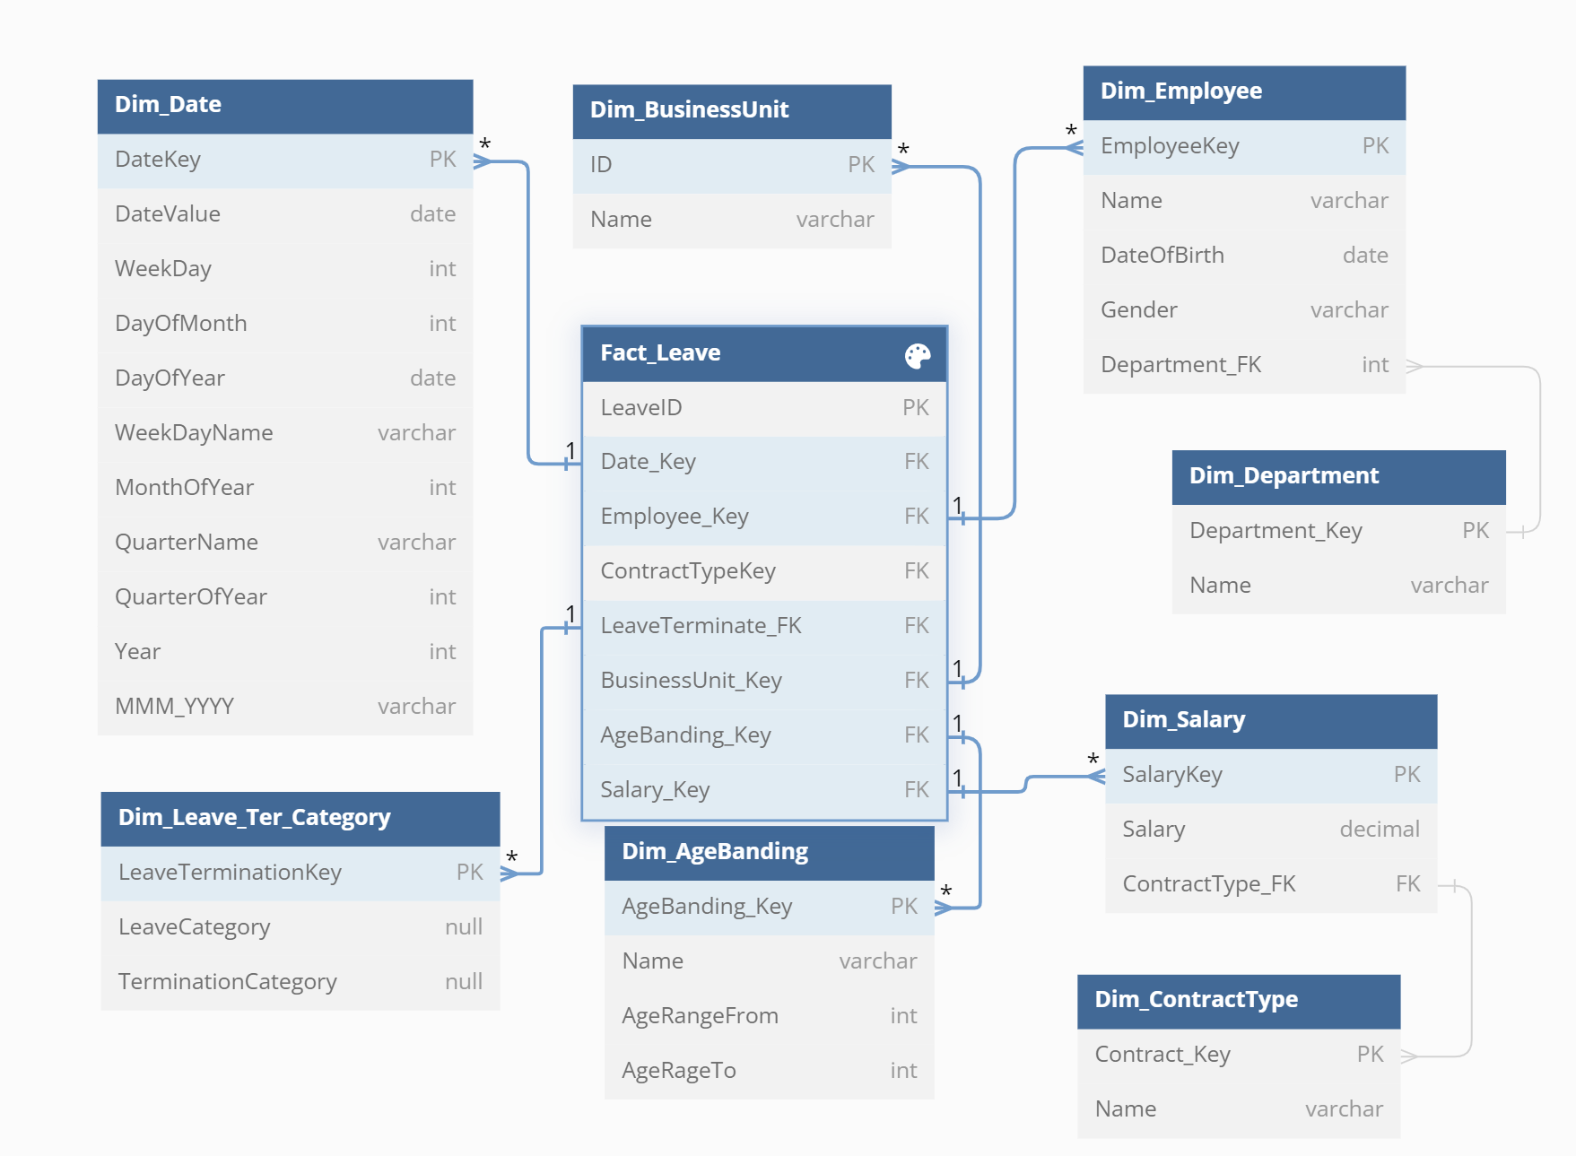

Slide 16
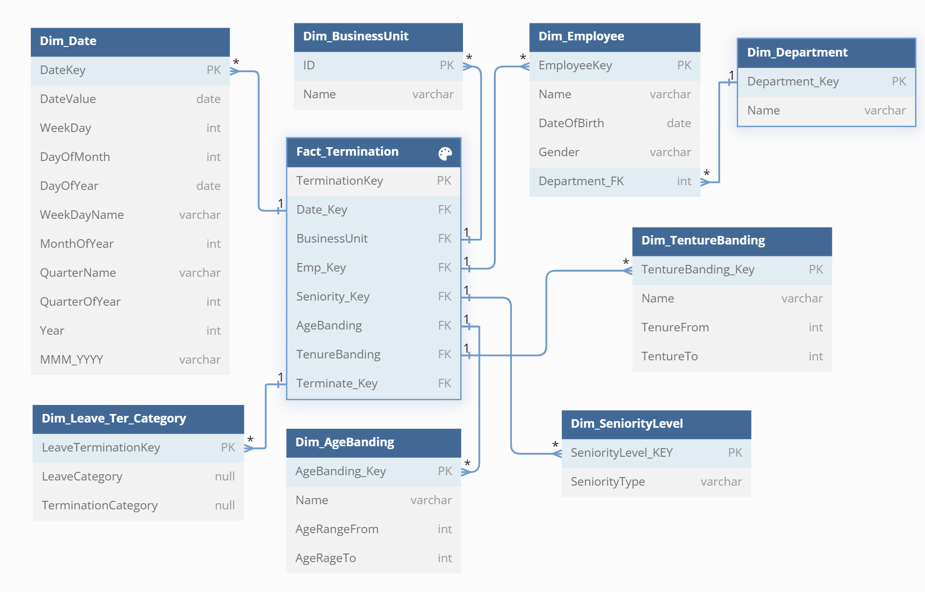

Slide 17
Thanks for
Watching & Listening
oceanwork2820@gmail.com | + 84 0966 614 097

